Slide 1

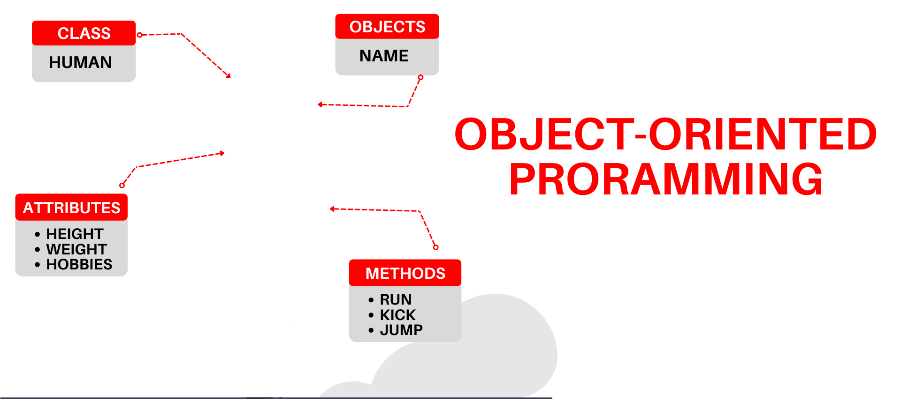

National University of Computer and Emerging Sciences
Spring 2022
Hira Naveed
Lecture # 1 Introduction

Slide 2


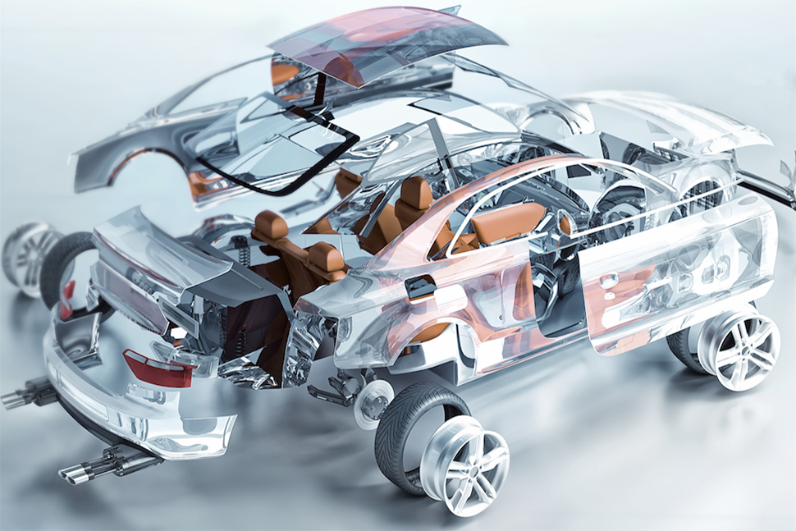


About me
BS(CS) – NUST (2014-2018)
MS(SE) – FAST (2018-2020)
Full Scholarship from Quest Lab
Bronze Medal
Research Assistant – QUEST Lab
Courses Taught:
Data Structures
Programming Fundamentals

Slide 3
Contact Details
Email: hira.naveed@nu.edu.pk
Office:
Room 304-F, 3rd Floor Block A
Contact Hours
Tuesday: 11:30 to 05:15
Wednesday: 02:30 to 04:00
You can email and check my availability before coming at any other time

Slide 4
Some Rules
Raise your hand before asking any question
Don’t miss a class
No retakes (except for Mid or Final Exam)
Don’t “sleep” in the class
You might miss a quiz ☹
Avoid using mobile phone in the class
Above all, whatever you do, please do not disturb others

Slide 5

How to be successful in this course??
Apne ghabrana nai hai

Slide 6
How to be successful in this course??
Be interactive, ask questions
Participate in the lecture, relax, and learn
Practice coding
Do try to solve the sample problems
Ask questions asap and get help when needed
Start on assignments early
Talk to your peers
Share ideas, not code

Slide 7
Attendance Policy
Attendance will be taken at the beginning of the lecture
80% attendance is mandatory
Students coming late will be marked as late
2 late arrivals are equal to an absent
Short Attendance in Lab will result in FA grade in Lab (debarred).

Slide 8

Dishonesty, Plagiarism
All parties involved in any kind of cheating in (Quizzes, Assignments & Projects) will get ZERO in that exam
Plagiarism threshold 25%
Plagiarism in midterm/ final exam may result in F grade in the course
Habitual cases will be awarded F

Slide 9
Google Classroom Code
gkwaioj

Slide 10

About you?
Introduce yourself
Name
Where are you from
Thoughts about PF?
Expectation from this course

Slide 11
Evaluation Breakdown
Absolute Grading
75% Theory 25% Lab

Slide 12
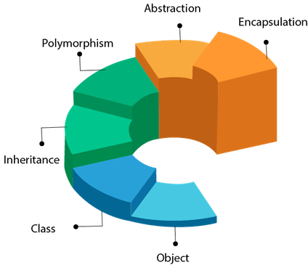
Course objective
In simple words, you will learn how to write object-oriented programs

Slide 13
Course Content
Memory Layout, Pointers, DMA Recursion Structures Classes Constructors Friend classes and friend functions | FIRST SESSION
Constant members Static data members and functions Overloading Composition, association and aggregation Inheritance | SECOND SESSION
Inheritance Polymorphism Virtual functions Abstract classes File Handling Templates | THIRD SESSION

Slide 14

What is Object Oriented Programming?
Procedural programs are organized as a series of steps or instructions that execute one by one, OOP provides another way to organize your programs
Object oriented programs are organized as groups of objects that have certain attributes and can take certain actions.
When the program executes these objects
interact with each other.
Notes:
Shelves example

Slide 15



Some Examples of Objects
Attributes:
on (true/false)
Behavior
Switch on
Switch off
Check if on
Car
Attributes:
Gas in tank
Mileage
Behavior
Accelerate
Brake
Load fuel
Check fuel
Light Bulb
Attributes:
balance
Behavior
Deposit
Withdraw
Check balance
Bank Account
Notes:
Shelves example

Slide 16


Objects Interact with each other
Get Loan
Bank
Customer
Deduct Zakat
Deposit
Withdraw
Bank Account

Slide 17
Why do we need Object Oriented Programming?
Due to the limitations of procedural programming (even after structuring into functions and files)
No matter how well structured the program is, as the size of the program increases it becomes excessively complex
But why does this happen??
Notes:
Shelves example

Slide 18
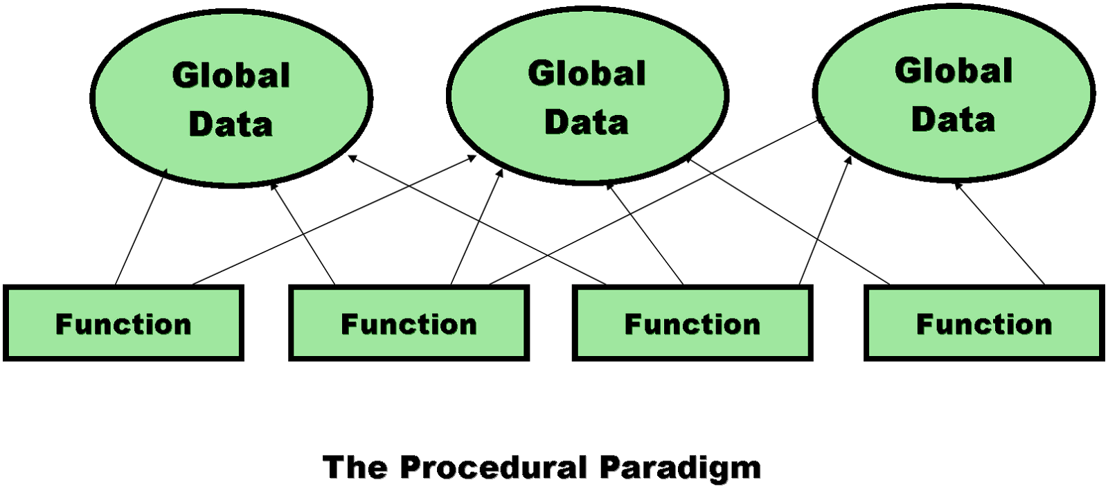
Limitations of procedural programming
1. Unrestricted Access
Global data can be accessed by any function in the program
Notes:
Shelves example

Slide 19
Limitations of procedural programming
Program structure
Difficult to conceptualize
Difficult to modify
1. Unrestricted Access
Global data can be accessed by any function in the program
Notes:
Shelves example

Slide 20
Limitations of procedural programming
OOP Programs
Easy to conceptualize
Easy to modify
2. Poor Real-World Modeling
Procedural programming arranges data and functions separately.
In the real world we deal with objects such as people and cars. Such objects aren’t like data and they aren’t like functions
Complex real-world objects have both attributes and behavior
Notes:
Shelves example

Slide 21
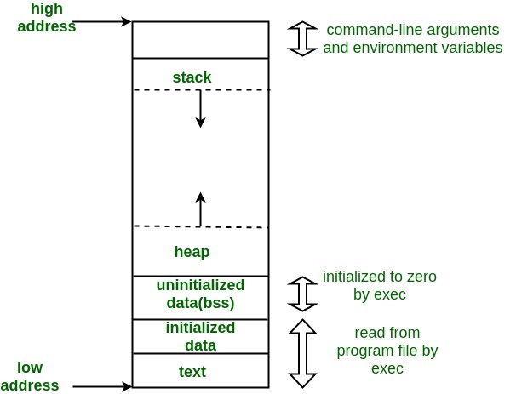
Memory Layout and Pointers

Slide 22
From C++ Code to Process
C++ source files
filename.cpp; .h
Binary files
filename.obj
Executable (Windows)
filename.exe
Process
Managed by OS
C++ source code
compiling
binary files
linking
executable
running
process

Slide 23
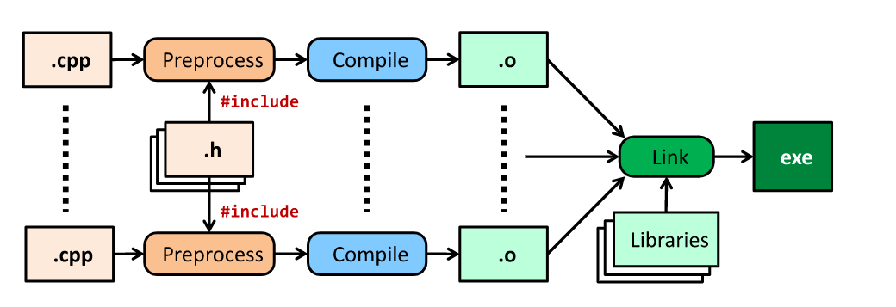
From C++ Code to Process
.h and .cpp files contain source code
Preprocessor performs code substitutions (e.g. #include <iostream>)
Compiler converts expanded source code to object code
Linker links object code file to external libraries (e.g. GLUT) and produces and executable file
Loader brings executable file into memory and starts executing it

Slide 24
C++ Memory Models
C++ leaves memory management mostly up to the programmer
Advantage: write programs that use memory very efficiently
Drawback: write programs that waste memory or do not work at all
For efficient program working, we need good understanding of the memory models

Slide 25
C++ Memory Models
Common errors due to poor memory management:
Using a variable before it has been initialized
Allocating memory for storage and not deleting it
Using a value after it has been deleted
Solutions??

Slide 26
Main Memory
Network
Audio
CPU
Data Bus
Disk
Video
Memory
shared by all processes

Slide 27
Virtual Memory (How a CPU see’s a Process?)
Continuous memory space for all process:
Set of locations as needed by a process
0
0xffffffff

Slide 28
Organization of Virtual Memory: Text
Program code and constant
loaded libraries
code instructions
space calculated at compile-time
0
text
0xffffffff

Slide 29
Organization of Virtual Memory: Data & BSS
Data: initialized global data in the program
E.g: int size = 100;
BSS: un-initialized global data in the program
E.g: int length;
0
text
data
bss
0xffffffff
Notes:
BSS: Better Save Space
BSS: block started by symbol

Slide 30
Organization of Virtual Memory: Heap
Heap: dynamically-allocated spaces
E.g: new, delete
dynamically grows as program runs
0
text
data
bss
heap
0xffffffff

Slide 31
Organization of Virtual Memory: Stack
Stack: local variables in functions
support function call/return and recursive functions
grow to low address
0
text
data
bss
heap
stack
0xffffffff

Slide 32
Summary: Process Address Space
text: program text/code
data: initialized globals & static data
bss: un-initialized globals & static data
heap: dynamically managed memory
stack: function’s local variables
0
text
data
bss
heap
stack
0xffffffff

Slide 33
Example
char *string = “hello”;
int iSize=8;
char* f(int x)
{
char *p;
p = new char[iSize];
return p;
}
0
text
data
bss
heap
stack
0xffffffff

Slide 34
Example
char *string = “hello”;
int iSize=8;
char* f(int x)
{
char *p;
p = new char[iSize];
return p;
}
0
text
data
bss
heap
stack
0xffffffff

Slide 35
Variable Lifetime
text:
program startup
program finish
data, bss:
program startup
program finish
heap:
dynamically allocated
de-allocated (free)
stack:
function call
function return
0
text
data
bss
heap
stack
0xffffffff

